Slide 1

ML/DL for Everyone with
Lecture 2: Linear Model

Slide 2

Machine Learning
What would be the grade if I study 4 hours?
4 hours
? points
Prediction
Hours (x) | Points (y)
1 | 2
2 | 4
3 | 6
4 | ?
Training dataset
Test dataset

Slide 3
Math and computer approaches
Hours (x) | Points (y)
1 | 2
2 | 4
3 | 6
4 | ?
y = w * x → How do you know it is multiplication?
2 = w * 1 → Use labeled value to predict
w = 2 → This is math way

Slide 4
How about this?
Hours (x) | Points (y)
1 | 13.5724
7 | 10.23315
16 | 22.5731
224 | -15.7414
How do you know it is linear or not?
How can you know there exists a solution to this?
How can you know that some data are noise?

Slide 5

Machine Learning
What would be the grade if I study 4 hours?
4 hours
? points
Prediction
Hours (x) | Points (y)
1 | 2
2 | 4
3 | 6
4 | ?
Training dataset
Supervised learning
Test dataset

Slide 6

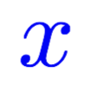
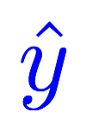
Model design
What would be the best model for the data? Linear?
Hours (x) | Points (y)
1 | 2
2 | 4
3 | 6
4 | ?
Linear
Notes:
\hat{y}=x*w+b

Slide 7

Model design
What would be the best model for the data? Linear?
Hours (x) | Points (y)
1 | 2
2 | 4
3 | 6
4 | ?
Linear
Notes:
\hat{y}=x*w+b

Slide 8
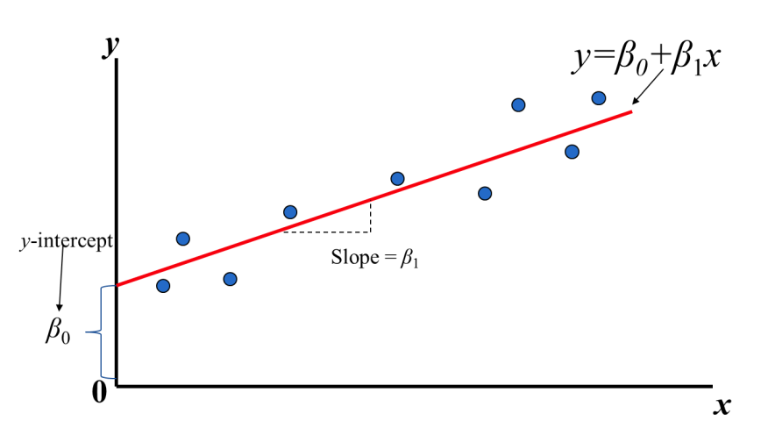
Linear Regression
Find the line that best fits the distributoion
Hours (x) | Points (y)
1 | 2
2 | 4
3 | 6
4 | ?
Notes:
\hat{y}=x*w+b

Slide 9
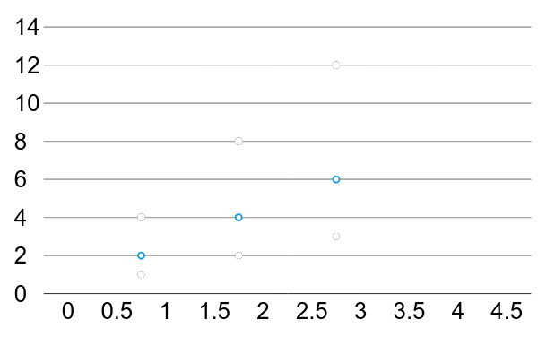
Linear Regression
For simplication, get rid of b
* The machine starts with a random guess, w=random value
Hours (x) | Points (y)
1 | 2
2 | 4
3 | 6
True line

Slide 10
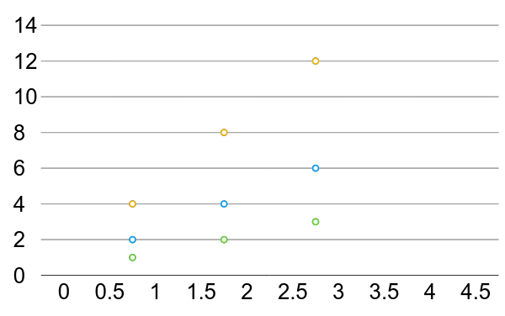
Linear Regression error?
* The machine starts with a random guess, w=random value
Hours (x) | Points (y)
1 | 2
2 | 4
3 | 6

Slide 11
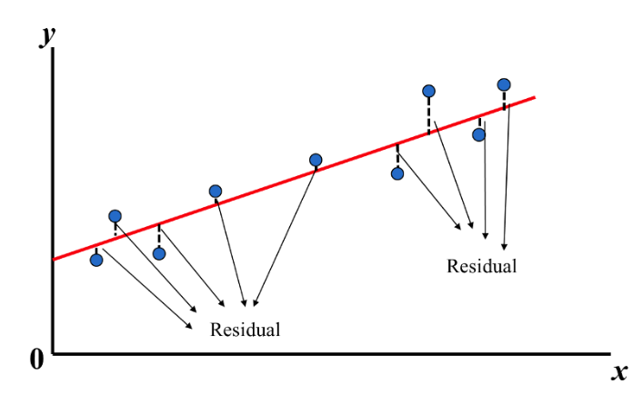
Linear Regression error?
Find the red line that all the ‘y’ distances are minimal
* The machine starts with a random guess, w=random value
Hours (x) | Points (y)
1 | 2
2 | 4
3 | 6

Slide 12
Training Loss (error) Make it positive and easy to get derivation
Hours, x | Points, y | Prediction, y^(w=3) | Loss (w=3)
1 | 2 | 3 | 1
2 | 4 | 6 | 4
3 | 6 | 9 | 9
 |  |  | mean=14/3
Notes:
loss = (\hat{y}-y)^2 = (x*w-y)^2

Slide 13
Training Loss (error)
Hours, x | Points, y | Prediction, y^(w=4) | Loss (w=4)
1 | 2 | 4 | 4
2 | 4 | 8 | 16
3 | 6 | 12 | 36
 |  |  | mean=56/3
Notes:
loss = (\hat{y}-y)^2 = (x*w-y)^2

Slide 14
Training Loss (error)
Hours, x | Points, y | Prediction, y^(w=0) | Loss (w=0)
1 | 2 | 0 | 4
2 | 4 | 0 | 16
3 | 6 | 0 | 36
 |  |  | mean=56/3
Notes:
loss = (\hat{y}-y)^2 = (x*w-y)^2

Slide 15
Training Loss (error)
Hours, x | Points, y | Prediction, y^(w=1) | Loss (w=1)
1 | 2 | 1 | 1
2 | 4 | 2 | 4
3 | 6 | 3 | 9
 |  |  | mean=14/3
Notes:
loss = (\hat{y}-y)^2 = (x*w-y)^2

Slide 16
Training Loss (error)
Hours, x | Points, y | Prediction, y^(w=2) | Loss (w=2)
1 | 2 | 2 | 0
2 | 4 | 4 | 0
3 | 6 | 6 | 0
 |  |  | mean=0
Notes:
loss = (\hat{y}-y)^2 = (x*w-y)^2

Slide 17
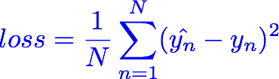
Training Loss (error)
MSE, mean square error
Hours, x | Loss (w=0) | Loss (w=1) | Loss (w=2) | Loss (w=3) | Loss (w=4)
1 | 4 | 1 | 0 | 1 | 4
2 | 16 | 4 | 0 | 4 | 16
3 | 36 | 9 | 0 | 9 | 36
 | MSE=56/3=18.7 | MSE=14/3=4.7 | MSE=0 | MSE=14/3=4.7 | MSE=56/3=18.7
Notes:
loss = (\hat{y}-y)^2 = (x*w-y)^2

Slide 18
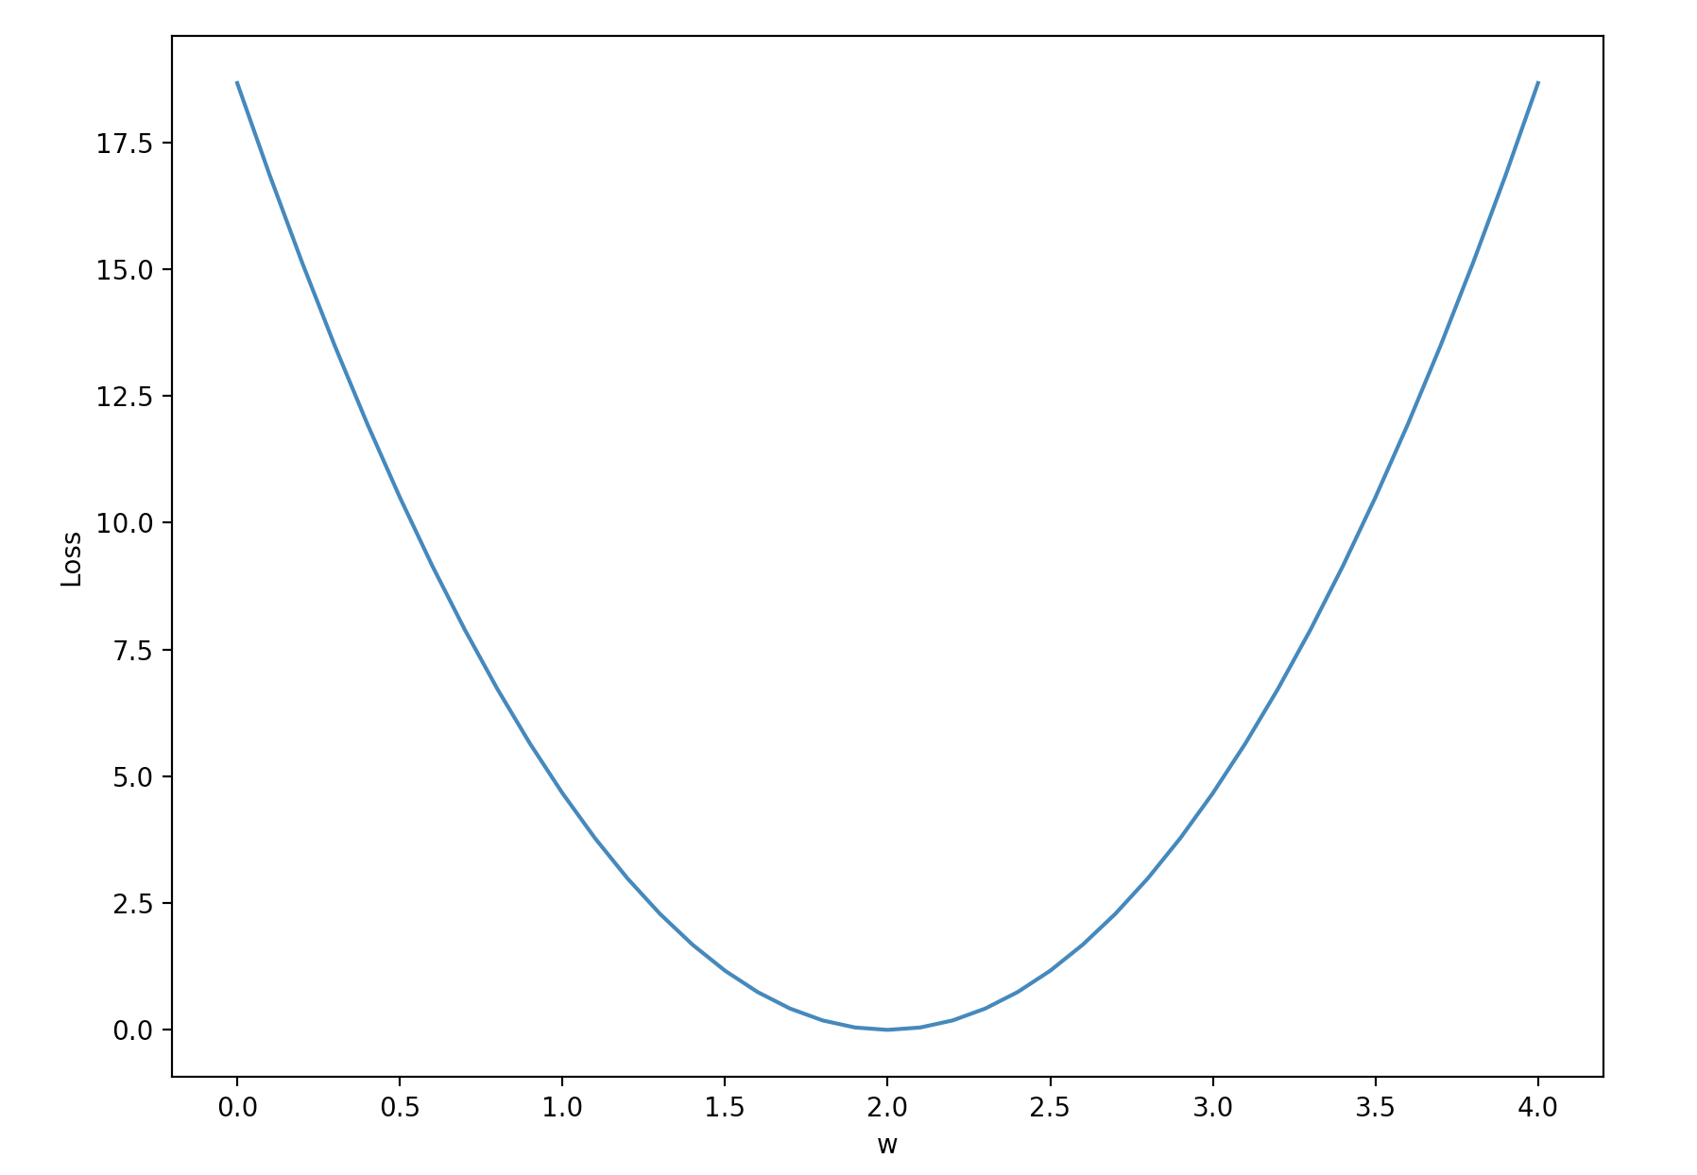
Loss graph
Loss (w=0) | Loss (w=1) | Loss (w=2) | Loss (w=3) | Loss (w=4)
mean=56/3=18.7 | mean=14/3=4.7 | mean=0 | mean=14/3=4.7 | mean=56/3=18.7
Loss
w
Notes:
loss = (\hat{y}-y)^2 = (x*w-y)^2

Slide 19
Loss graph
Loss (w=0) | Loss (w=1) | Loss (w=2) | Loss (w=3) | Loss (w=4)
mean=56/3=18.7 | mean=14/3=4.7 | mean=0 | mean=14/3=4.7 | mean=56/3=18.7
Loss
w
Notes:
loss = (\hat{y}-y)^2 = (x*w-y)^2

Slide 20


Model & Loss
w = 1.0 # a random guess: random value
# our model for the forward pass
def forward(x):
return x * w
# Loss function
def loss(x, y):
y_pred = forward(x)
return (y_pred - y) * (y_pred - y)

Slide 21

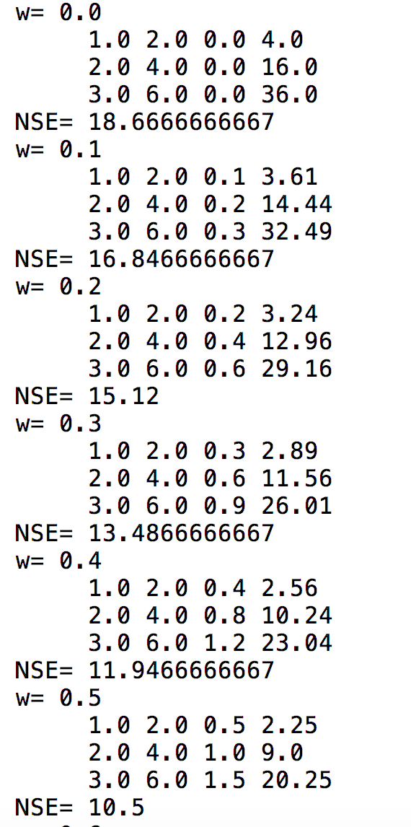
Compute loss for w
for w in np.arange(0.0, 4.1, 0.1):
print("w=", w)
l_sum = 0
for x_val, y_val in zip(x_data, y_data):
y_pred_val = forward(x_val)
l = loss(x_val, y_val)
l_sum += l
print("\t", x_val, y_val, y_pred_val, l)
print("MSE=", l_sum / 3)

Slide 22
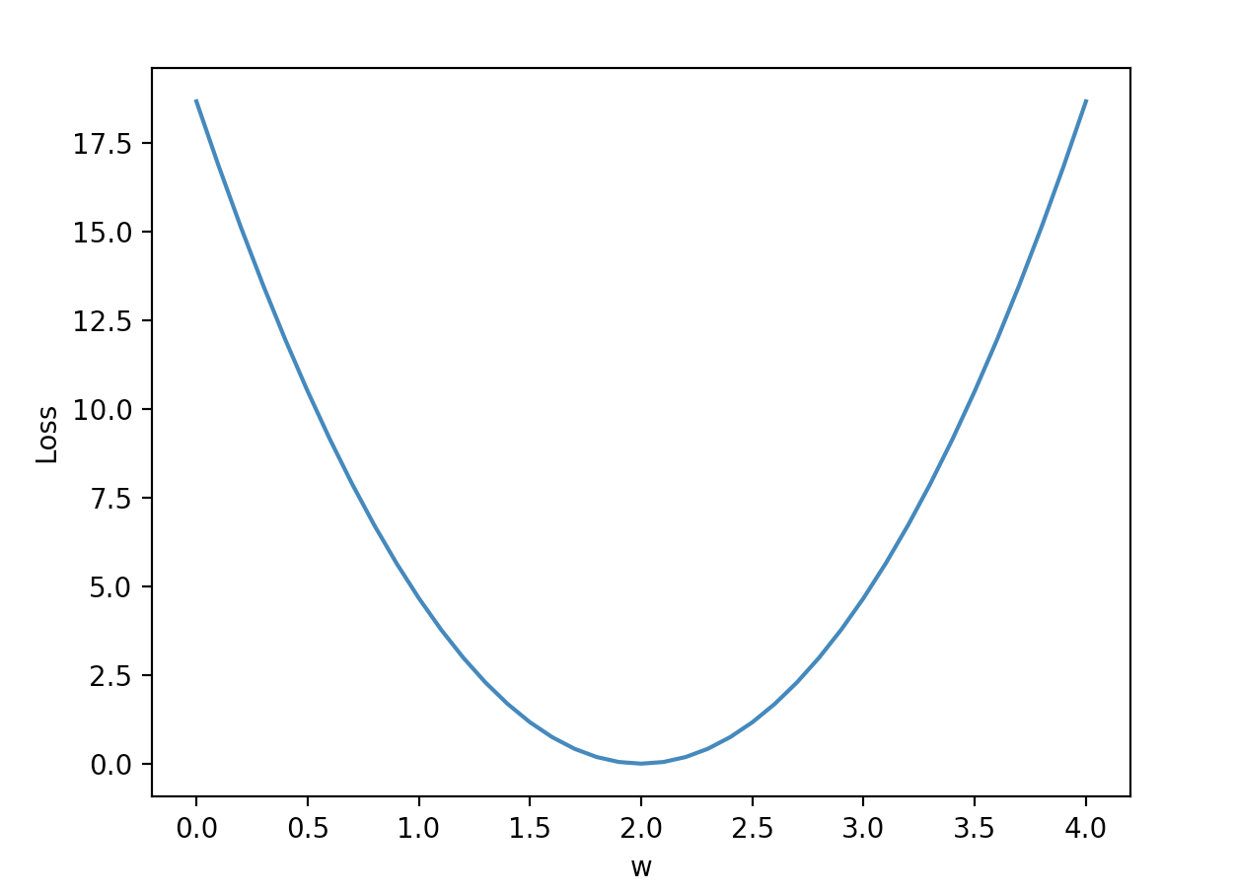
Plot graph
w_list = []
mse_list = []
for w in np.arange(0.0, 4.1, 0.1):
print("w=", w)
l_sum = 0
for x_val, y_val in zip(x_data, y_data):
y_pred_val = forward(x_val)
l = loss(x_val, y_val)
l_sum += l
print("\t", x_val, y_val, y_pred_val, l)
print("MSE=", l_sum / 3)
w_list.append(w)
mse_list.append(l_sum / 3)
plt.plot(w_list, mse_list)
plt.ylabel('Loss')
plt.xlabel('w')
plt.show()

Slide 23
import numpy as np
import matplotlib.pyplot as plt
x_data = [1.0, 2.0, 3.0]
y_data = [2.0, 4.0, 6.0]
w = 1.0 # a random guess: random value, 1.0
# our model for the forward pass
def forward(x):
return x * w
# Loss function
def loss(x, y):
y_pred = forward(x)
return (y_pred - y) * (y_pred - y)
w_list = []
mse_list = []
for w in np.arange(0.0, 4.1, 0.1):
print("w=", w)
l_sum = 0
for x_val, y_val in zip(x_data, y_data):
y_pred_val = forward(x_val)
l = loss(x_val, y_val)
l_sum += l
print("\t", x_val, y_val, y_pred_val, l)
print("MSE=", l_sum / 3)
w_list.append(w)
mse_list.append(l_sum / 3)
plt.plot(w_list, mse_list)
plt.ylabel('Loss')
plt.xlabel('w')
plt.show()
Linear

Slide 24
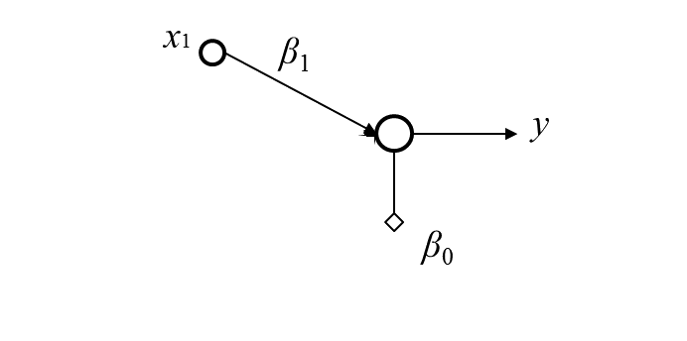
Linear Regression
One dimension linear regression

Slide 25

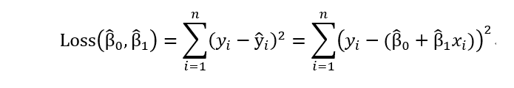

Calculate Bias and Weight
Notes:
loss = (\hat{y}-y)^2 = (x*w-y)^2

Slide 26
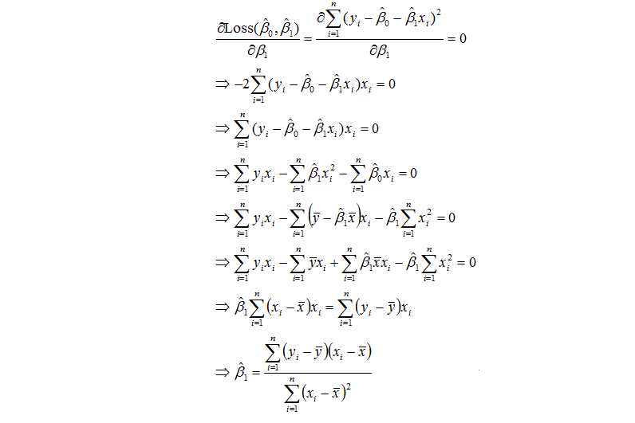
Calculate Bias and Weight
Notes:
loss = (\hat{y}-y)^2 = (x*w-y)^2

Slide 27
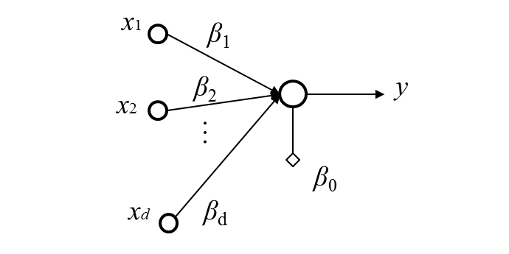
Linear Regression
Multi-dimension linear regression

Slide 28
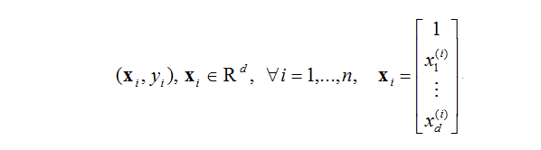
Calculate Bias and Weight
Notes:
loss = (\hat{y}-y)^2 = (x*w-y)^2

Slide 29
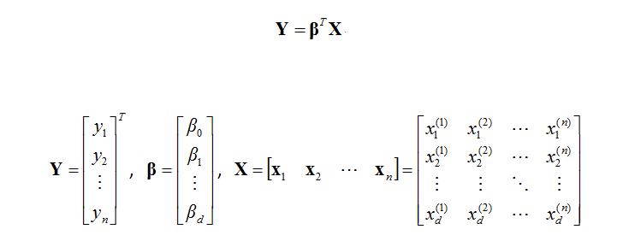
Calculate Bias and Weight
Notes:
loss = (\hat{y}-y)^2 = (x*w-y)^2

Slide 30
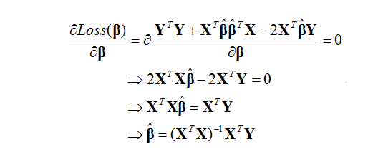
Calculate Bias and Weight
Notes:
loss = (\hat{y}-y)^2 = (x*w-y)^2

Slide 31

Calculate Bias and Weight
Notes:
loss = (\hat{y}-y)^2 = (x*w-y)^2

Slide 32
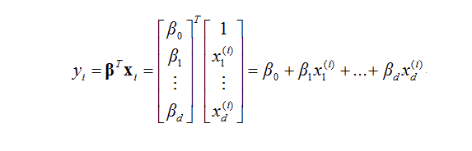
Calculate Bias and Weight
Notes:
loss = (\hat{y}-y)^2 = (x*w-y)^2

